Slide 1
IP addressing made easy
Md. Akhtaruzzaman Adnan

Slide 2
TASK
Please watch the video I have shared in classroom. Write down the questions you did not understand.

Slide 3
IP Address
An IP (Internet Protocol) address is a unique address that different computers or devices on a computer network use to identify and communicate with one another.
An IP address is used as an identifier to find electronic devices connected to one another on a network.
Therefore, each device in the network must have its own unique address.
An IP address is like a mailing address that is used to deliver data (files) to a computer.

Slide 4
Cont..
Some IP addresses are meant to be unique within the scope of the Internet, whereas others are meant to be unique within the scope of a specific network.
The Internet Assigned Numbers Authority (IANA) creates and manages IP addresses for the public Internet.
IANA allocates the superblocks of addresses to Regional Internet Registries, which in turn allocate smaller blocks of addresses to Internet service providers

Slide 5
Brief History
In May 1974, the Institute of Electrical and Electronics Engineers (IEEE) published a paper entitled "A Protocol for Packet Network Intercommunication".
The paper's authors, Vint Cerf and Bob Kahn, described an internetworking protocol for sharing resources using packet switching among network nodes.
A central control component of this model was the "Transmission Control Program" that incorporated both connection-oriented links and datagram services between hosts. The model became known as the Department of Defense (DoD) Internet Model and Internet protocol suite, and informally as TCP/IP.

Slide 6
IP versions 1 to 3 were experimental versions, designed between 1973 and 1978.
The dominant internetworking protocol in the Internet Layer in use is IPv4; the number 4 identifies the protocol version, carried in every IP datagram. IPv4 is described in RFC 791 (1981).
Version number 5 was used by the Internet Stream Protocol, an experimental streaming protocol that was not adopted.

Slide 7
The successor to IPv4 is IPv6. IPv6 was a result of several years of experimentation and dialog during which various protocol models were proposed, such as TP/IX (RFC 1475), PIP (RFC 1621) and TUBA (TCP and UDP with Bigger Addresses, RFC 1347).
Its most prominent difference from version 4 is the size of the addresses.
While IPv4 uses 32 bits for addressing, yielding 2³² ⁼ approx. 4.3 billion (4.3×10⁹) addresses, IPv6 uses 128-bit addresses providing 2¹²⁸ = 3.4×10³⁸ addresses.

Slide 8
In this article, we review some of the basics of IPv4 address layout, and then consider a technique to make working with IPv4 addresses easier.
Although this is not the “conventional” method you might have been taught to work with in IP address space, you will find it is very easy and fast.
We conclude with a discussion of applying those techniques to the IPv6 address space.

Slide 9
The success of TCP/IP as the network protocol of the Internet is largely because of its ability to connect together networks of different sizes and systems of different types.
These networks are arbitrarily defined into three main classes (along with a few others) that have predefined sizes, each of which can be divided into smaller sub networks by system administrators.
A subnet mask is used to divide an IP address into two parts. One part identifies the host (computer), the other part identifies the network to which it belongs.
To better understand how IP addresses and subnet masks work, look at an IP (Internet Protocol) address and see how it is organized.

Slide 10
Basic IPv4 Addressing
IPv4 addresses are essentially 32-bit binary numbers; computer systems and routers do not see any sorts of divisions within the IPv4 address space.
To make IPv4 addresses more human-readable, however, we break them up into four sections divided by dots, commonly called “octets.”
An octet is a set of eight binary digits, sometimes also called a “byte.”

Slide 11
Address Space
A protocol like IPv4 that defines addresses has an address space.
An address space is the total number of addresses used by the protocol. If a protocol uses b bits to define an address, the address space is 2 to the power b because each bit can have two different values (0 or 1).
IPv4 uses 32-bit addresses, which means that the address space is 2
To the power 32 or 4,294,967,296 (more than four billion). Theoretically, if there were no restrictions, more than 4 billion
devices could be connected to the Internet.

Slide 12
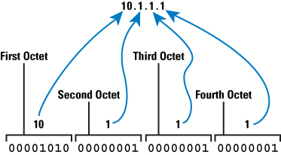
Figure 1 illustrates the IPv4 address structure
Lowest=00000000 00000000 0000000 0000000= 0. 0. 0. 0
Highest=11111111 11111111 11111111 11111111=255.255.255.255
Range 0-255=total numers In 1 octet=256
DOTTED DECIMAL NOTAION

Slide 13
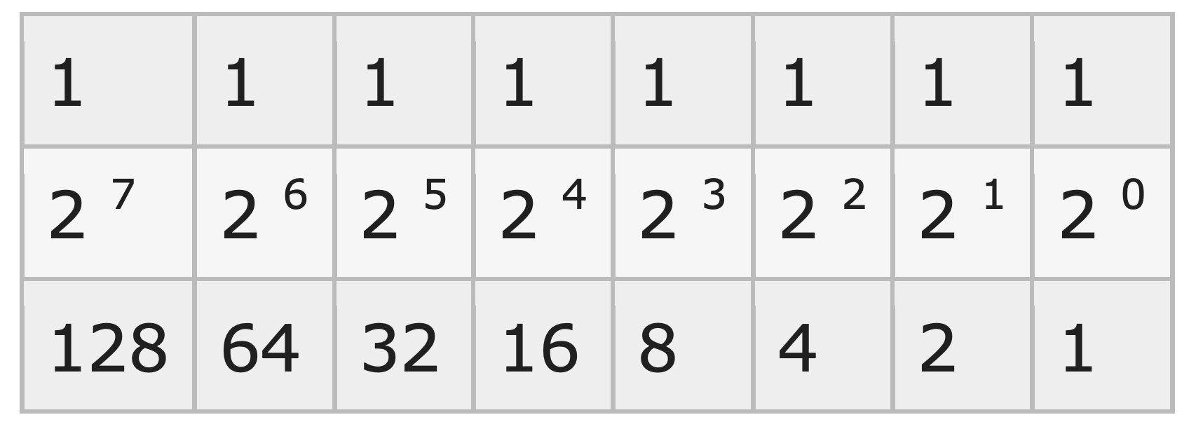
Switch is on
11111111 (binary octet) = 128 + 64 + 32 + 16 + 8 + 4 + 2 + 1= 255
( decimal format)
1
1
o
o
1
o
o
o
200 (decimal) =128+64+0+0+8+0+0+0=
11001000 (binary)
128=10000000
129=10000001
254=11111110

Slide 14
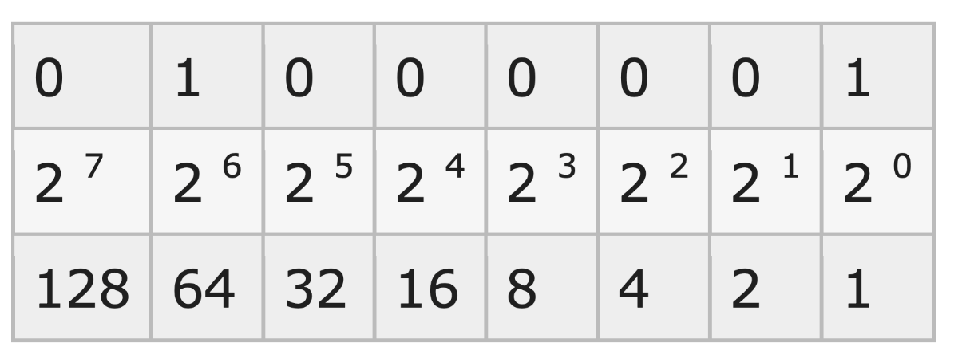
Switch is on/off
01000001 (binary octet) = 0+64+0+0+0+0+0+0+1 = 65 (decimal format)
00000000= 0+0+0+0+0+0+0+0+0=0

Slide 15
At a glance
The lowest value of any octet is =00000000=0
The highest value of any octet is=11111111=255
A single octet has a range of 0-255
Total numbers in one octet = 256
Total octets in IPv4=4
Total numbers in IPv4 = 4 * 256=1024

Slide 16
IP addresses: Networks and hosts
An IP address is a 32-bit number that uniquely identifies a host (computer or other device, such as a printer or router) on a TCP/IP network.
IP addresses are normally expressed in dotted-decimal format, with four numbers separated by periods, such as 192.168.123.132.
To understand how subnet masks are used to distinguish between hosts, networks, and subnetworks, examine an IP address in binary notation.

Slide 17
For example, the dotted-decimal IP address 192.168.123.132 is (in binary notation) the 32 bit number 110000000101000111101110000100.
This number may be hard to make sense of, so divide it into four parts of eight binary digits.
These eight bit sections are known as octets. The example IP address, then, becomes 11000000.10101000.01111011.10000100.

Slide 18
Change the following IPv4 addresses from binary notation to dotted-decimal notation and vice versa.
a.
10000001 00001011 00001011 11101111
b.
11000001 10000011 00011011 11111111
c.
11100111 11011011 10001011 01101111
d.
11111001 10011011 11111011 00001111
A. 25.220.26.117 odd
B. 45.66.225.122 even

Slide 19
Solution
We replace each group of 8 bits with its equivalent decimal number (see Appendix B) and add
dots for separation:
a.
129.11.11.239
b.
193.131.27.255
c.
231.219.139.111
d.
249.155.251.15

Slide 20
Example
Find the error, if any, in the following IPv4 addresses:
a.
111.56.045.78
b.
221.34.7.8.20
c.
75.45.301.14
d.
11100010.23.14.67

Slide 21
Solution
a.
There should be no leading zeroes in dotted-decimal notation (045).
b.
We may not have more than 4 bytes in an IPv4 address.
c.
Each byte should be less than or equal to 255; 301 is outside this range.
d.
A mixture of binary notation and dotted-decimal notation is not allowed.

Slide 22
Range of Addresses
We often need to deal with a range of addresses instead of one single address.
We sometimes need to find the number of addresses in a range if the first and last address is given. Other times, we need to find the last address if the first address and the number of addresses in the range are given. In this case, we can perform subtraction or addition

Slide 23
Example
Find the number of addresses in a range if the first address is 146.102.29.0 and the last address is 146.102.32.255.
Solution
We can subtract the first address from the last address in base 256. The result is 0.0.3.255 in this base. To find the number of addresses in the range (in decimal), we convert this number to base 10 and add 1 to the result.
Number of addresses =(0 × 256³ +0 ×256² + 3× 256¹+ 255×256⁰)+1=1024

Slide 24
Example
The first address in a range of addresses is 14.11.45.96. If the number of addresses in the range is 32, what is the last address?
Solution
We convert the number of addresses minus 1 to base 256, which is 0.0.0.31. We then add it to the first address to get the last address. Addition is in base 256.
Last address=(14.11.45.96+0.0.0.31)₂₅₆=14.11.45.127

Slide 25
Operations
We often need to apply some operations on 32-bit numbers in binary or dotted-decimal
notation. There are three operations that are used : NOT, AND, and OR.

Slide 26
Bitwise NOT Operation
The bitwise NOT operation is a unary operation; it takes one input. When we apply the NOT operation on a number, it is often said that the number is complemented. The
NOT operation, when applied to a 32-bit number in binary format, inverts each bit.
Every 0 bit is changed to a 1 bit; every 1 bit is changed to a 0 bit.

Slide 27
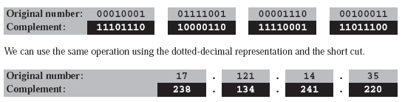
Although we can directly use the NOT operation on a 32-bit number, when the number is represented as a four-byte dotted-decimal notation, we can use a short cut; we can subtract each byte from 255.

Slide 28
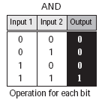
Bitwise AND Operation
The bitwise AND operation is a binary operation; it takes two inputs. The AND operation compares the two corresponding bits in two inputs and selects the smaller bit
from the two (or select one of them if the bits are equal).

Slide 29

Although we can directly use the AND operation on the 32-bit binary representation of two numbers.

Slide 30
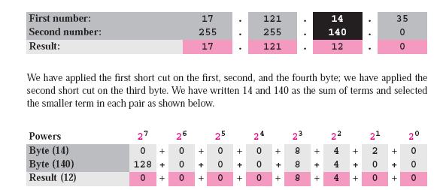
When the numbers are represented in dotted-decimal notation, we can use two short cuts.
1. When at least one of the numbers is 0 or 255, the AND operation selects the smaller byte (or one of them if equal).
2. When none of the two bytes is either 0 or 255, we can write each byte as the sum of eight terms, where each term is a power of 2. We then select the smaller term in each pair (or one of them if equal) and add them to get the result.

Slide 31
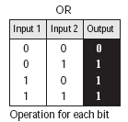
Bitwise OR Operation
The bitwise OR operation is a binary operation; it takes two inputs. The OR operation compares the corresponding bits in the two numbers and selects the larger bit from the two (or one of them if equal). Figure 5.4 shows the OR operation.

Slide 32
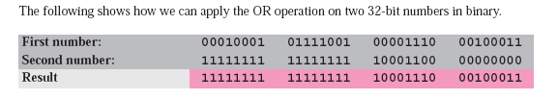
Although we can directly use the OR operation on the 32-bit binary representation of the two numbers.

Slide 33
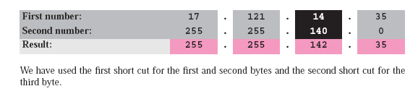
when the numbers are represented in dotted-decimal notation, we can use two short cuts.
1. When at least one of the two bytes is 0 or 255, the OR operation selects the larger
byte (or one of them if equal).
2. When none of the two bytes is 0 or 255, we can write each byte as the sum of eight terms, where each term is a power of 2. We then select the larger term in each pair (or one of them if equal) and add them to get the result of OR operation.

Slide 34
CLASSFUL ADDRESSING
IP addresses, when started a few decades ago, used the concept of classes. This architecture is called classful addressing.
In the mid-1990s, a new architecture, called classless addressing, was introduced that supersedes the original architecture. In this section, we introduce classful addressing because it paves the way for understanding classless addressing and justifies the rationale for moving to the new architecture.

Slide 35
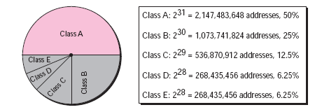
Classes
In classful addressing, the IP address space is divided into five classes: A, B, C, D, and E. Each class occupies some part of the whole address space. Figure shows the class occupation of the address space.

Slide 36
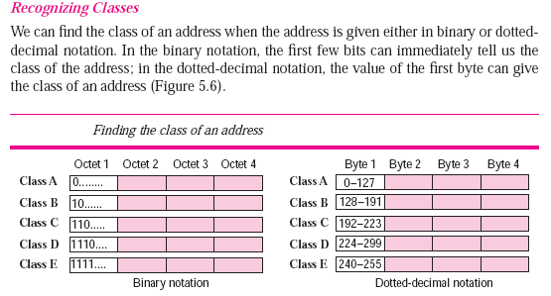
Class A range=00000000 to 01111111

Slide 37
Class A
1st byte Lowest 00000000 =0
1st byte highest 01111111=127
Class B
Lowest 10000000=128
Highest 10111111=191
C
11000000=192
11011111=223

Slide 38
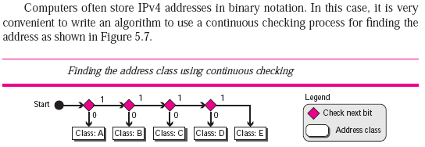
Example Find the class of each address: a. 00000001 00001011 00001011 11101111 b. 11000001 10000011 00011011 11111111 c. 10100111 11011011 10001011 01101111 d. 11110011 10011011 11111011 00001111

Slide 39
Solution
See the procedure in Figure 5.7.
a. The first bit is 0. This is a class A address.
b. The first 2 bits are 1; the third bit is 0. This is a class C address.
c. The first bit is 1; the second bit is 0. This is a class B address.
d. The first 4 bits are 1s. This is a class E address.

Slide 40
Example 5.11
Find the class of each address:
a. 227.12.14.87=
b. 193.14.56.22=
c. 14.23.120.8=
d. 252.5.15.111=

Slide 41
Solution
a. The first byte is 227 (between 224 and 239); the class is D.
b. The first byte is 193 (between 192 and 223); the class is C.
c. The first byte is 14 (between 0 and 127); the class is A.
d. The first byte is 252 (between 240 and 255); the class is E.

Slide 42
Two-Level Addressing
The whole purpose of IPv4 addressing is to define a destination for an Internet packet (at the network layer).
When classful addressing was designed, it was assumed that the whole Internet is divided into many networks and each network connects many hosts.
In other words, the Internet was seen as a network of networks. A network was normally
created by an organization that wanted to be connected to the Internet. The Internet
authorities allocated a block of addresses to the organization (in class A, B, or C).

Slide 43
Since all addresses in a network belonged to a single block, each address in classful addressing contains two parts: netid and hostid.
The netid defines the network; the hostid defines a particular host connected to that network. Figure 5.14 shows an IPv4
address in classful addressing. If n bits in the class defines the net, then 32 − n bits
defines the host. However, the value of n depends on the class the block belongs to. The
value of n can be 8, 16 or 24 corresponding to classes A, B, and C respectively.

Slide 44
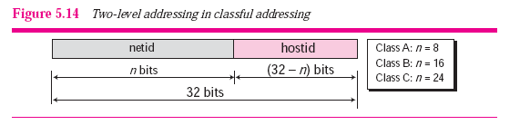
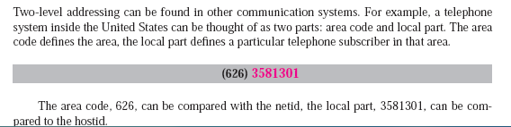

Slide 45
Netid and Hostid
In classful addressing, an IP address in classes A, B, and C is divided into netid and hostid.
These parts are of varying lengths, depending on the class of the address.
Note that classes D and E are not divided into netid and hostid.

Slide 46
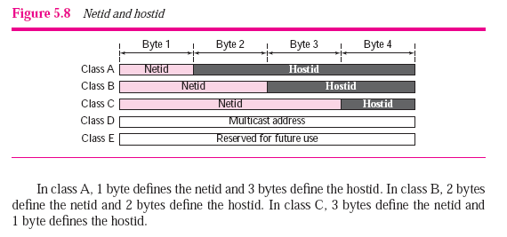
^{2 to the power 24=1.67 crores}

Slide 47
Classes and Blocks
One problem with classful addressing is that each class is divided into a fixed number of blocks with each block having a fixed size. Let us look at each class.
Class A (2147483648 addresses)
Since only 1 byte in class A defines the netid and the leftmost bit should be 0, the next 7 bits can be changed to find the number of blocks in this class. Therefore, class A is divided into 2⁷ = 128 blocks that can be assigned to 128 organizations.
However, each block in this class contains (2147483648/128) = 16,777,216 (2²⁴) IP addresses, which means the organization should be a really large one to use all these addresses. Many addresses are wasted in this class.

Slide 48
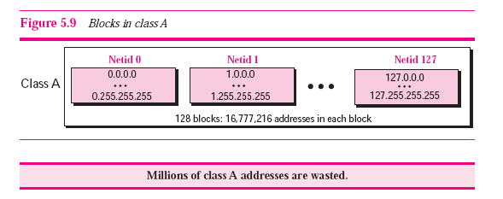

Slide 49
Class B (1073741824 addresses)
Since 2 bytes in class B define the class and the two leftmost bit should be 10 (fixed), the next 14 bits can be changed to find the number of blocks in this class.
Therefore, class B is divided into 2¹⁴ = 16,384 blocks that can be assigned to 16,384 organizations.
However, each block in this class contains 2¹⁶ 65,536 addresses. (1073741824/16384=65536)
Not so many organizations can use so many addresses. Many addresses are wasted in this class.

Slide 50
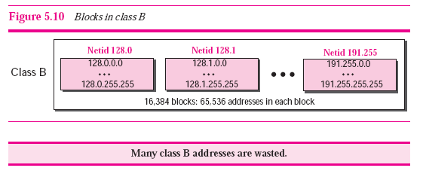

Slide 51
Class C (536870912 addresses)
Since 3 bytes in class C define the class and the three leftmost bits should be 110 (fixed), the
next 21 bits can be changed to find the number of blocks in this class.
Therefore, class C is divided into 2²¹ = 2,097,152 blocks, in which each block contains 256 addresses, that can be assigned to 2,097,152 organizations.
However, not so many organizations were so small as to be satisfied with a class C block.

Slide 52
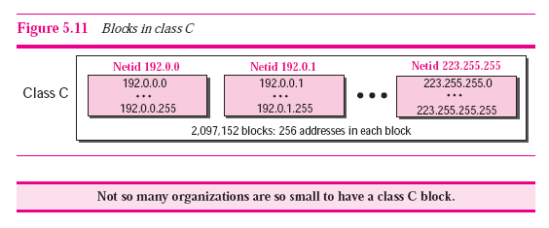

Slide 53
Private IP Address and Public IP Address are used to uniquely identify a machine on the internet.
Private IP address is used with a local network and public IP address is used outside the network.
Public IP address is provided by ISP, Internet Service Provider.

Slide 54
Sr. No. | Key | Private IP Address | Public IP Address
1 | Scope | Private IP address scope is local to present network. | Public IP address scope is global.
2 | Communication | Private IP Address is used to communicate within the network. | Public IP Address is used to communicate outside the network.
3 | Format | Private IP Addresses differ in a uniform manner. | Public IP Addresses differ in varying range.
4 | Provider | Local Network Operator creates private IP addresses using network operating system. | ISP, Internet Service Provider controls the public IP address.
5 | Cost | Private IP Addresses are free of cost. | Public IP Address comes with a cost.
6 | Locate | Private IP Address can be located using ipconfig command. | Public IP Address needs to be searched on search engine like google.
7 | Range | Private IP Address range:10.0.0.0 – 10.255.255.255, 172.16.0.0 – 172.31.255.255, 192.168.0.0 – 192.168.255.255 | Except private IP Addresses, rest IP addresses are public.
8 | Example | Private IP Address is like 192.168.11.50. | Public IP Address is like 17.5.7.8.

Slide 55
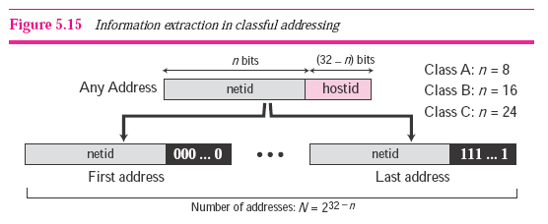
Extracting Information in a Block
A block is a range of addresses.
Given any address in the block, we normally like to know three pieces of information about the block: the number of addresses, the first address, and the last address.
Before we can extract these pieces of information, we need to know the class of the address, which we showed how to find in the previous section.
After the class of the block is found, we know the value of n, the length of netid in bits. We can now find these three pieces of information.
1. The number of addresses in the block, N, can be found using N = 2^{32−n}.
2. To find the first address, we keep the n leftmost bits and set the (32−n ) rightmost bits all to 0s.
3. To find the last address, we keep the n leftmost bits and set the (32−n) rightmost bits all to 1s.

Slide 56
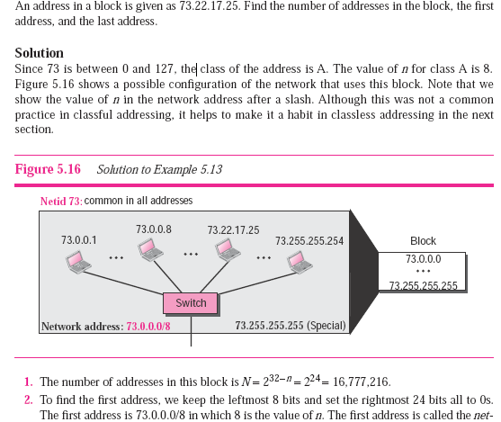


Slide 57
TEST1 An address in a block is given as 180.8.17.9. Find the number of addresses in the block, the first address, and the last address.

Slide 58
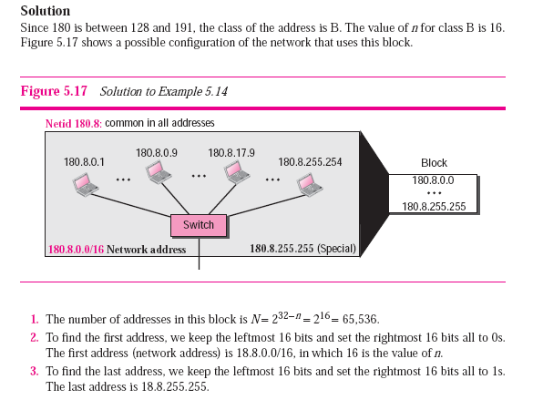

Slide 59
Test 2
An address in a block is given as 200.11.8.45. Find the number of addresses in the block, the first address, and the last address

Slide 60
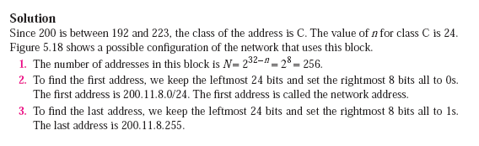
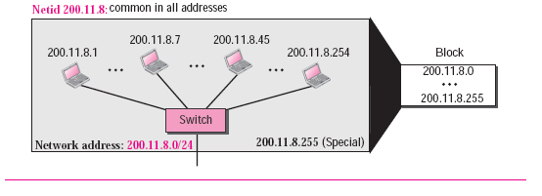

Slide 61
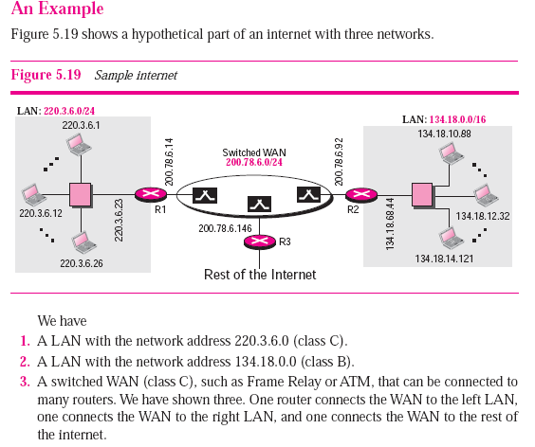

Slide 62
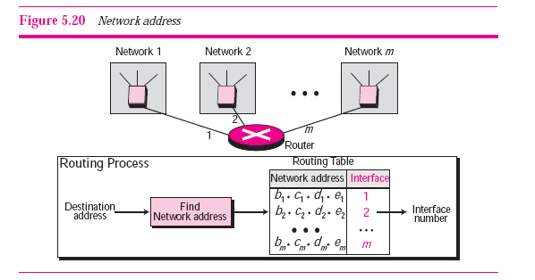
Network Address
The first address, network address, is particularly important because it is used in routing a packet to its destination network. For the moment, let us assume that an internet is made of m networks and a router with m interfaces. When a packet arrives at the router from any source host, the router needs to know to which network the packet should be sent; the router needs to know from which interface the packet should be sent out.
When the packet arrives at the network, it reaches its destination host using another strategy that we discuss in later chapters. Figure 5.20 shows the idea. After the network address has been found, the router consults its routing table to find the corresponding interface from which the packet should be sent out. The network address is actually the identifier of the network; each network is identified by its network address.

Slide 63
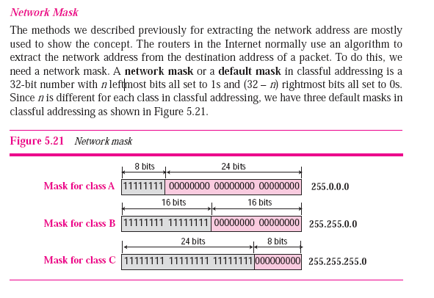
Network Mask

Slide 64
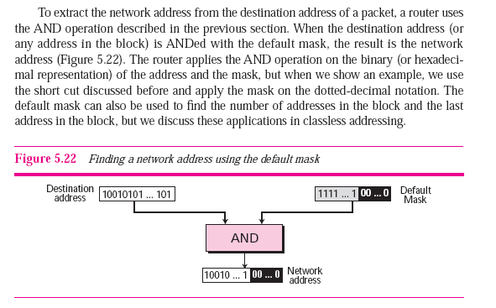

Slide 65
Do yourself
A router receives a packet with the destination address 201.24.67.32. Show how the router finds the network address of the packet.

Slide 66
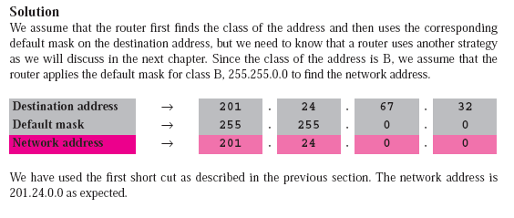
255
67

Slide 67
Three-Level Addressing: Subnetting
As we discussed before, the IP addresses were originally designed with two levels of addressing. To reach a host on the Internet, we must first reach the network and then the host.
But It soon became clear that we need more than two hierarchical levels, for two reasons.
First, an organization that was granted a block in class A or B needed to divide its large network into several subnetworks for better security and management.
Second, since the blocks in class A and B were almost depleted (low) and the blocks in class C were smaller than the needs of most organizations, an organization that has been granted a block in class A or B could divide the block into smaller subblocks and share them with other organizations.

Slide 68
IMPORTANT!!!
The idea of splitting a block to smaller blocks is referred to as subnetting.
In subnetting, a network is divided into several smaller subnetworks (subnets) with each subnetwork having its own subnetwork address.

Slide 69
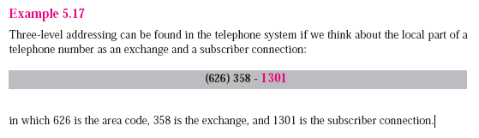

Slide 70
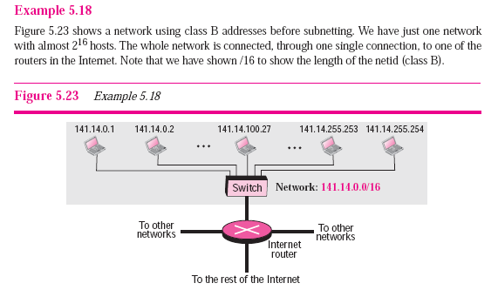

Slide 71
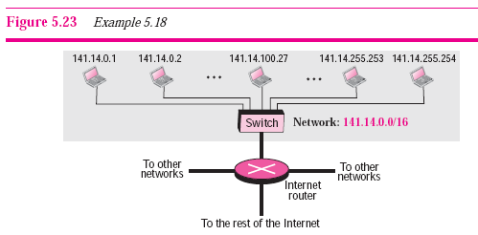
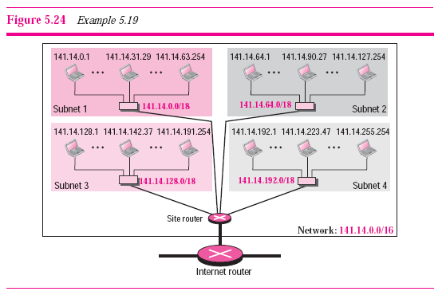
Figure 5.24 shows the same network in Figure 5.23 after subnetting. The whole network is still connected to the Internet through the same router. However, the network has used a private router to divide the network into four subnetworks. The rest of the Internet still sees only one network; internally the network is made of four subnetworks.
Each subnetwork can now have almost 2¹⁴ hosts. The network can belong to a university campus with four different schools (buildings).
After subnetting, each school has its own subnetworks, but still the whole campus is one network for the rest of the Internet. Note that /16 and /18 show the length of the netid and subnetids.

Slide 72
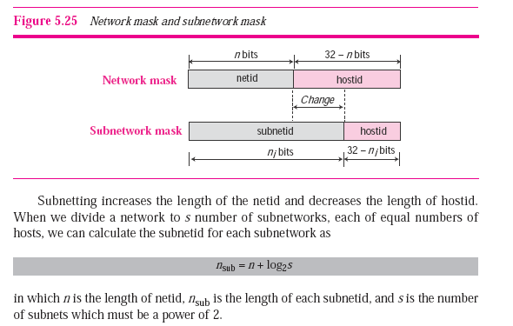
Subnet Mask
We discussed the network mask (default mask) before. The network mask is used when a network is not subnetted. When we divide a network to several subnetworks, we need to create a subnetwork mask (or subnet mask) for each subnetwork. A subnetwork has subnetid and hostid as shown in Figure 5.25.

Slide 73
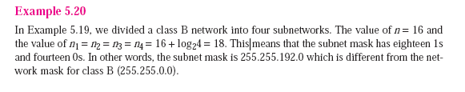
Subnet Mask

Slide 74
Subnet Address
When a network is subnetted, the first address in the subnet is the identifier of the subnet
and is used by the router to route the packets destined for that subnetwork. Given
any address in the subnet, the router can find the subnet mask using the same procedure
we discussed to find the network mask: ANDing the given address with the subnet
mask. The short cuts we discussed in the previous section can be used to find the subnet
address.

Slide 75
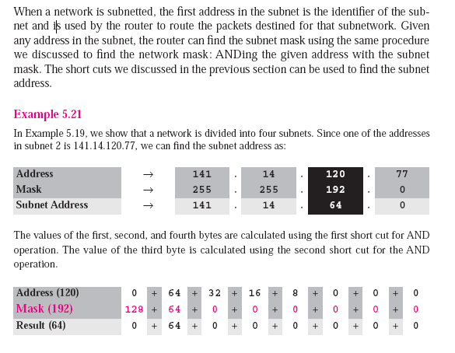

Slide 76
Classless addressing
Subnetting in classful addressing did not really solve the address depletion problem and made the distribution of addresses and the routing process more difficult.
With the growth of the Internet, it was clear that a larger address space was needed as a long-term solution. The larger address space, however, requires that the length of IP addresses to be increased, which means the format of the IP packets needs to be changed.
Although the long-range solution has already been devised and is called IPv6, a short-term solution was also devised to use the same address space but to change the distribution of addresses to provide a fair share to each organization.
The short-term solution still uses IPv4 addresses, but it is called classless addressing.
In other words, the class privilege was removed from the distribution to compensate for the address depletion.

Slide 77
Motivation
There was another motivation for classless addressing. During the 1990s, Internet service providers (ISPs) came into prominence. An ISP is an organization that provides Internet access for individuals, small businesses, and midsize organizations that do not want to create an Internet site and become involved in providing Internet services (such as e-mail services) for their employees.
An ISP can provide these services. An ISP is granted a large range of addresses and then subdivides the addresses (in groups of 1, 2, 4, 8, 16, and so on), giving a range of addresses to a household or a small business.
The customers are connected via a dial-up modem, DSL, or cable modem to the ISP.
However, each customer needs some IPv4 addresses.
In 1996, the Internet authorities announced a new architecture called classless addressing.
In classless addressing, variable-length blocks are used that belong to no classes. We can have a block of 1 address, 2 addresses, 4 addresses, 128 addresses, and so on.

Slide 78
Variable-Length Blocks
In classful addressing the whole address space was divided into five classes. Although each organization was granted one block in class A, B, or C, the size of the blocks was predefined; the organization needed to choose one of the three block sizes.
In classless addressing, the whole address space is divided into variable length blocks.
Theoretically, we can have a block of 2⁰, 2¹, 2², . . . , 2³² addresses.
The only restriction, as we discuss later, is that the number of addresses in a block needs to be a power of 2.
An organization can be granted one block of addresses.

Slide 79
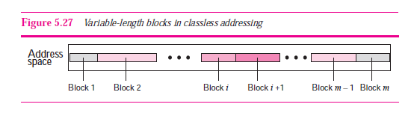
Figure 5.27 shows the division of the whole address space into nonoverlapping blocks.

Slide 80
Two-Level Addressing
In classful addressing, two-level addressing was provided by dividing an address into netid and hostid. The netid defined the network; the hostid defined the host in the network.
The same idea can be applied in classless addressing. When an organization is granted a block of addresses, the block is actually divided into two parts, the prefix and the suffix.
The prefix plays the same role as the netid; the suffix plays the same role as the hostid. All addresses in the block have the same prefix; each address has a different suffix.

Slide 81
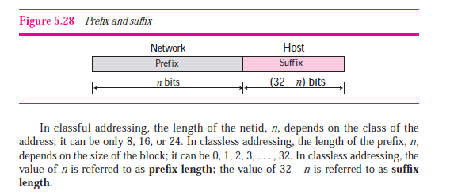
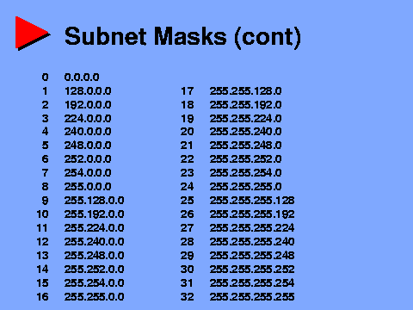
Figure 5.28 shows the prefix and suffix in a classless block.

Slide 82
NOTE!!
The number of addresses in a block is inversely related to the value of the prefix length, n.
A small n means a larger block; a large n means a small block.

Slide 83
Sr. No. | Key | Private IP Address | Public IP Address
1 | Scope | Private IP address scope is local to present network. | Public IP address scope is global.
2 | Communication | Private IP Address is used to communicate within the network. | Public IP Address is used to communicate outside the network.
3 | Format | Private IP Addresses differ in a uniform manner. | Public IP Addresses differ in varying range.
4 | Provider | Local Network Operator creates private IP addresses using network operating system. | ISP, Internet Service Provider controls the public IP address.
5 | Cost | Private IP Addresses are free of cost. | Public IP Address comes with a cost.
6 | Locate | Private IP Address can be located using ipconfig command. | Public IP Address needs to be searched on search engine like google.
7 | Range | Private IP Address range: A 10.0.0.0 – 10.255.255.255 B 172.16.0.0 – 172.31.255.255 C 192.168.0.0 – 192.168.255.255 | Except private IP Addresses, rest IP addresses are public.
8 | Example | Private IP Address is like 192.168.11.50 | Public IP Address is like 17.5.7.8

Slide 84
192.168.20.0/24
SM: 11111111 11111111 11111111 00000000
SM : 255.255.255.0
0-255=total 256
NA BA cant use =256-2=254
Network rule=2 to the power 0=1
HOST rule=2 to the power 8=256
11111111 11111111 11111111 10000000
N=1 =2 to the power 1=2 networks
H=7=2 to the power 7=128 hosts

Slide 85
N=0;H=8
2 to the power N=0
2 to the power H=256
IP block:192.168.20.0
Net add:192.168.20.0
1st ip/DG=192.168.20.1
BA:192.168.20.255
Last usable IP=192.168.20.254
SM: 255.255.255.0
256
254
N=1, H=7
2 to the power N=2
2 to the power H=128
N=2, H=6
2 to the power N=4
2 to the power H=64
32
32
16
16
16
64
64
16
32
32
16
16
128
126
128
126
16
16
32
32
16
16
64
64
16
16
32
32
16
16
16
16
Net ADNAN Add: 192.168.20.0
BA: 192.168.20.127
SM: 255.255.255.128
Net nazmul Add: 192.168.20.128
BA: 192.168.20.255
SM: 255.255.255.128
Net Add: 192.168.20.
BA: 192.168.20.
SM: 255.255.255.
Net Add: 192.168.20.
BA: 192.168.20.
SM: 255.255.255.
Net Add: 192.168.20.
BA: 192.168.20.
SM: 255.255.255.

Slide 86
192.168.20.0
192.168.20.128
192.168.20.127
nazmul
ADNAN
192.168.20.255
128
128
Net ADNAN Add: 192.168.20.0
BA: 192.168.20.127
SM: 255.255.255.128
Net nazmul Add: 192.168.20.128
BA: 192.168.20.255
SM: 255.255.255.128

Slide 87
Slash Notation
The netid length in classful addressing or the prefix length in classless addressing play a very important role when we need to extract the information about the block from a given address in the block.
However, there is a difference here in classful and classless addressing.
❑ In classful addressing, the netid length is inherent in the address. Given an address, we know the class of the address that allows us to find the netid length (8, 16, or 24).
❑ In classless addressing, the prefix length cannot be found if we are given only an address in the block. The given address can belong to a block with any prefix length.
In classless addressing, we need to include the prefix length to each address if we need to find the block of the address. In this case, the prefix length, n, is added to the address separated by a slash. The notation is informally referred to as slash notation.

Slide 88
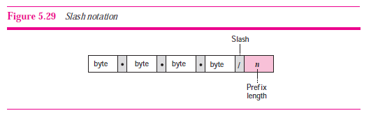
An address in classless addressing can then be represented as shown in Figure 5.29.
The slash notation is formally referred to as classless inter domain routing or CIDR (pronounced cider) notation.
In classless addressing, we need to know one of the addresses in the block and the prefix length to define the block.

Slide 89
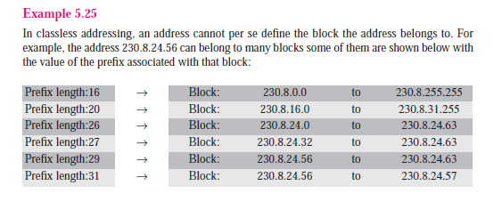

Slide 90
Network Mask
The idea of network mask in classless addressing is the same as the one in classful addressing. A network mask is a 32-bit number with the n leftmost bits all set to 0s and the rest of the bits all set to 1s.
Example
The following addresses are defined using slash notations.
a. In the address 12.23.24.78/8, the network mask is 255.0.0.0. The mask has eight 1s and twenty-four 0s. The prefix length is 8; the suffix length is 24.
b. In the address 130.11.232.156/16, the network mask is 255.255.0.0. The mask has sixteen 1s and sixteen 0s.The prefix length is 16; the suffix length is 16.
c. In the address 167.199.170.82/27, the network mask is 255.255.255.224. The mask has twenty-seven 1s and five 0s. The prefix length is 27; the suffix length is 5.

Slide 91
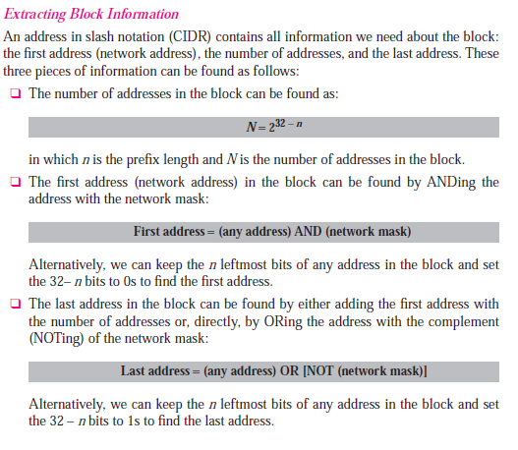

Slide 92
Test 5
One of the addresses in a block is 167.199.170.82/27. Find the number of addresses in the network, the first address, and the last address.

Slide 93
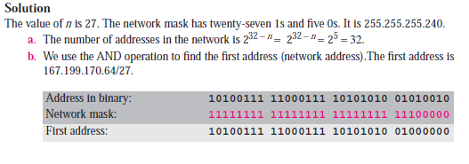
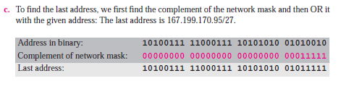

Slide 94
Test 6
One of the addresses in a block is 17.63.110.114/24. Find the number of addresses, the first address, and the last address in the block.

Slide 95
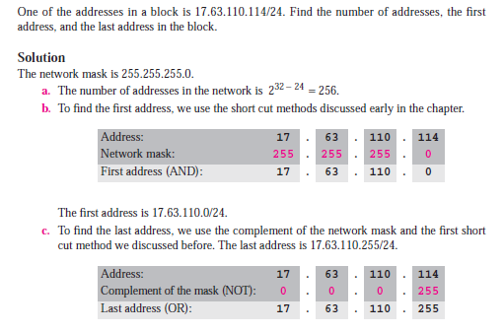

Slide 96
Test 7
One of the addresses in a block is 110.23.120.14/20. Find the number of addresses, the first address, and the last address in the block.

Slide 97
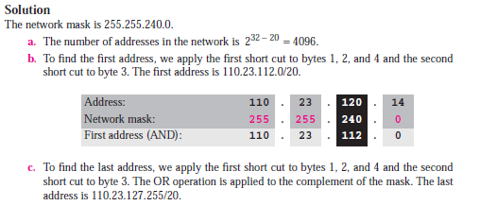


Slide 98
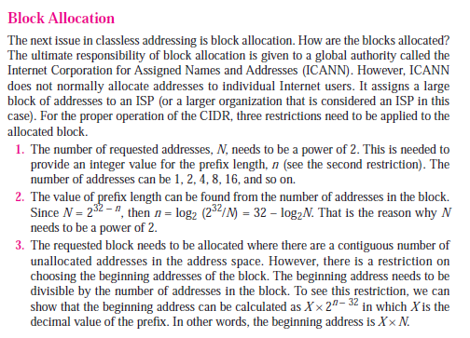
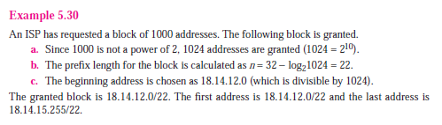

Slide 99
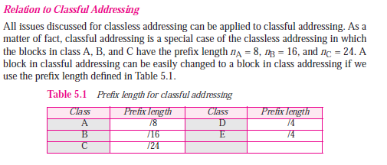

Slide 100
Subnetting
Three levels of hierarchy can be created using subnetting. An organization (or an ISP) that is granted a range of addresses may divide the range into several subranges and assign each subrange to a subnetwork (or subnet). The concept is the same as we discussed for classful addressing. Note that nothing stops the organization from creating more levels. A subnetwork can be divided into several sub-subnetworks. A sub-subnetwork can be divided into several sub-sub-subnetworks. And so on.

Slide 101
CIDR and Routing Information
Company X :
206.0.68.0/22
ISP X owns:
206.0.64.0/18
204.188.0.0/15
209.88.232.0/21
Internet Backbone
ISP y :
209.88.237.0/24
Organization z1 :
209.88.237.192/26
Organization z2 :
209.88.237.0/26

Slide 102
CIDR and Routing Information
Backbone routers do not know anything about Company X, ISP Y, or Organizations z1, z2.
Company X :
206.0.68.0/22
ISP X owns:
ISP X does not know about Organizations z1, z2.
ISP y sends everything which matches the prefix: 209.88.237.192/26 to Organizations z1 209.88.237.0/26 to Organizations z2
206.0.64.0/18
204.188.0.0/15
209.88.232.0/21
Internet Backbone
ISP X sends everything which matches the prefix: 206.0.68.0/22 to Company X,
209.88.237.0/24 to ISP y
ISP y :
209.88.237.0/24
Backbone sends everything which matches the prefixes 206.0.64.0/18, 204.188.0.0/15, 209.88.232.0/21 to ISP X.
Organization z1 :
209.88.237.192/26
Organization z2 :
209.88.237.0/26

Slide 103
Subnetting
Three levels of hierarchy can be created using subnetting. An organization (or an ISP) that is granted a range of addresses may divide the range into several subranges and assign each subrange to a subnetwork (or subnet). The concept is the same as we discussed for classful addressing. Note that nothing stops the organization from creating more levels. A subnetwork can be divided into several sub-subnetworks. A sub-subnetwork can be divided into several sub-sub-subnetworks. And so on.

Slide 104
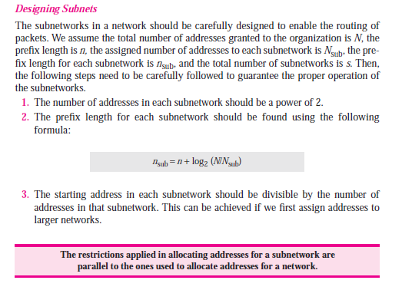

Slide 105
Test 8
An organization is granted the block 130.34.12.64/26.
The organization needs four subnetworks, each with an equal number of hosts.
Design the subnetworks and find the information about each network.

Slide 106
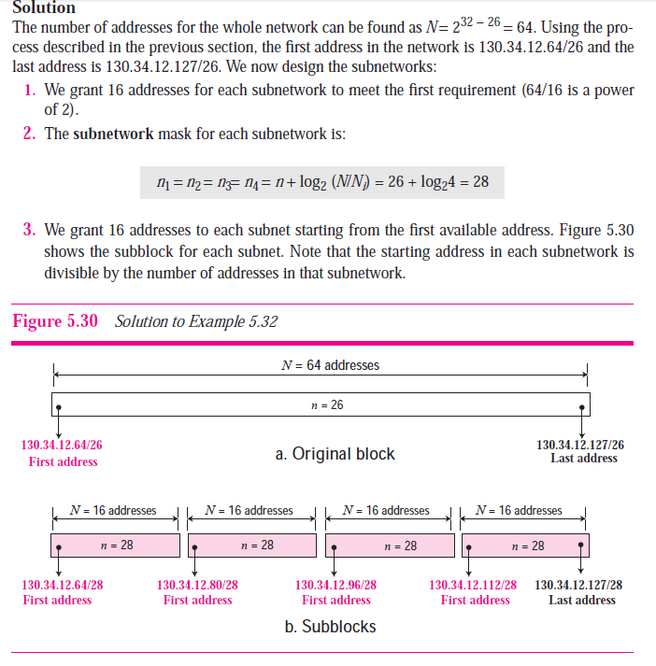

Slide 107
An organization is granted a block of addresses with the beginning address 14.24.74.0/24. The organization needs to have 3 subblocks of addresses to use in its three subnets as shown below:
❑ One subblock of 120 addresses.
❑ One subblock of 60 addresses.
❑ One subblock of 10 addresses.

Slide 108


Slide 109

14.24.74.192

Slide 110

Test 8
Assume a company has three offices: Central, East, and West. The Central office is connected to the East and West offices via private, point-to-point WAN lines.
The company is granted a block of 64 addresses with the beginning address 70.12.100.128/26.
The management has decided to allocate 32 addresses for the Central office and divides the rest of addresses between the two other offices.

Slide 111



Slide 112


Slide 113

Solution
Let us solve the problem in two steps. In the first step, we allocate a subblock of addresses to each group. The total number of addresses allocated to each group and the prefix length for each subblock can found as:

Slide 114


Slide 115
References
TCP-IP Protocol Suit by Behrouz A. Forouzan
CISCO online
Microsoft windows LAN technology

